Slide 1


IOT-ENABLED SMART WASTE COLLECTION SYSTEM WITH COMMUNITY SHARING AND REAL-TIME ROUTE OPTIMIZATION
RAKK RANASINGHE (D/BIT/22/0039)
Supervised By: Mr. RPS Kathriarachchi
BSc (Hons) in Information Technology – Faculty of Computing
Individual Research Project (IT4999) – Progress Review 1
Notes:
Good Evening Madam, I’m here to present my project titled IOT-ENABLED SMART WASTE COLLECTION SYSTEM WITH COMMUNITY SHARING AND REAL-TIME ROUTE OPTIMIZATION

Slide 2
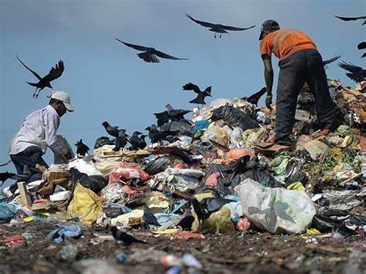
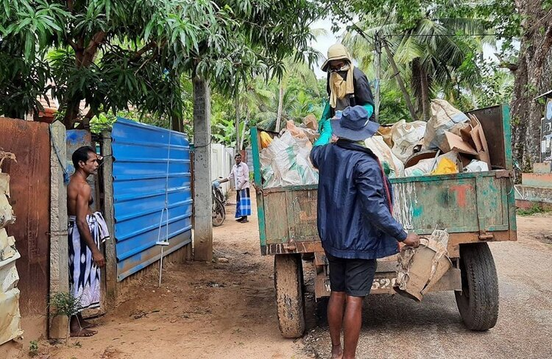
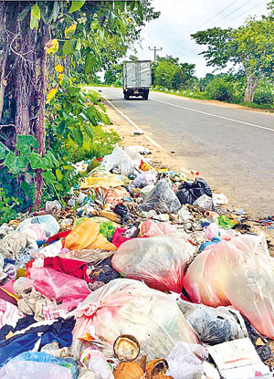
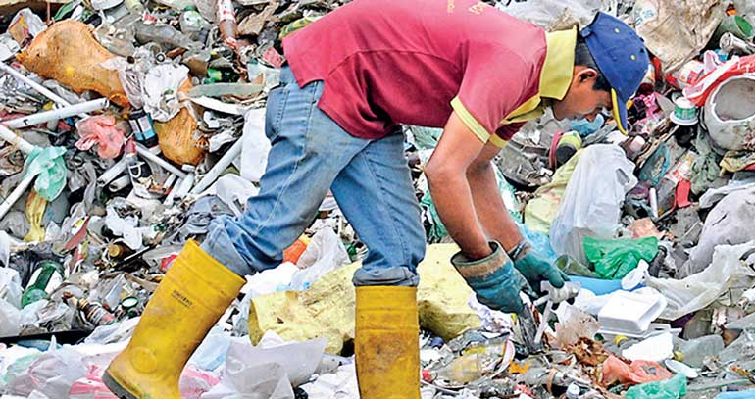
Familiar
with this ??
Notes:
Let me start by asking – are you familiar with the challenges we face in our daily waste collection ?

Slide 3
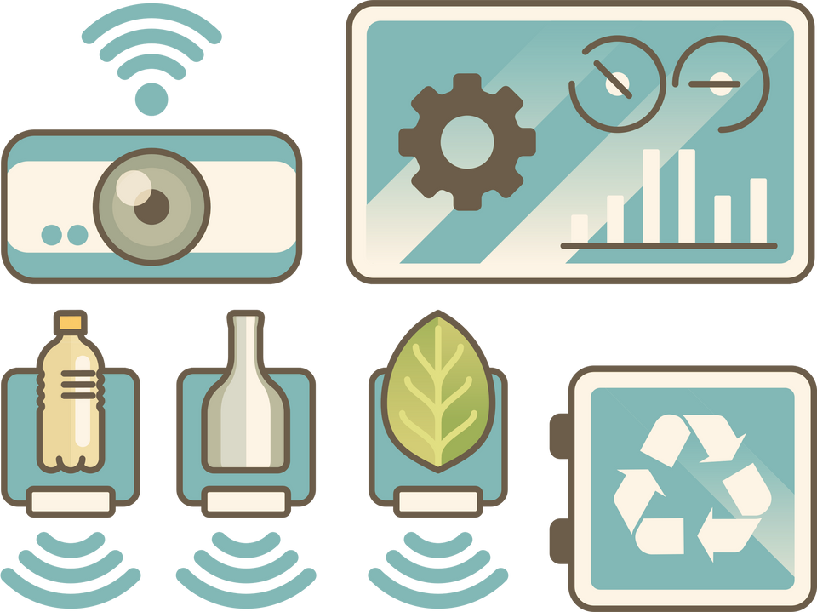
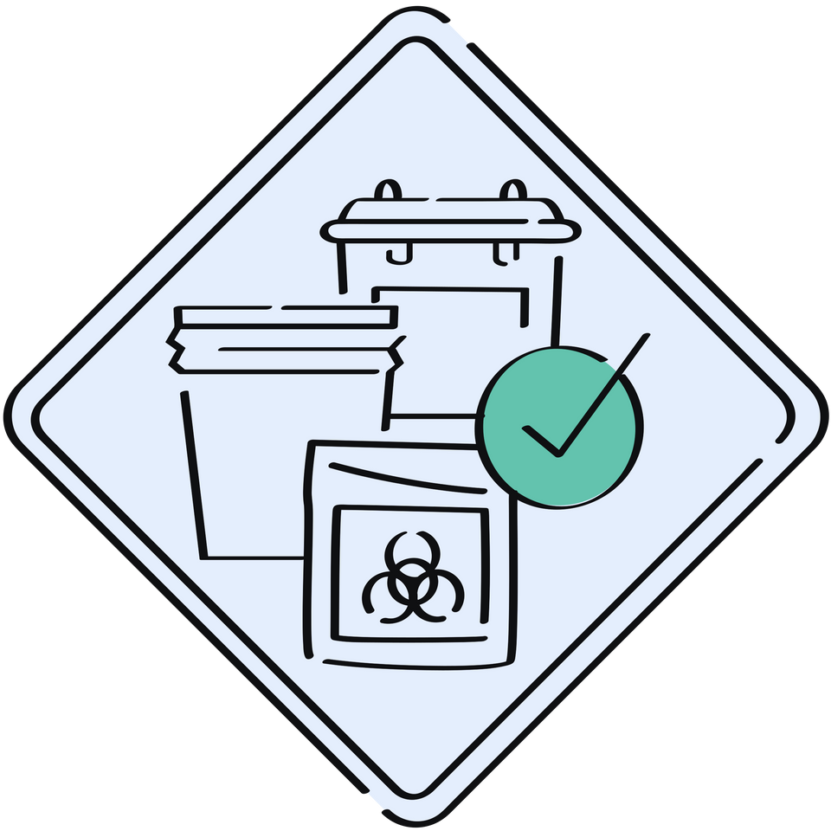
02
INTRODUCTION
Efficient waste collection is essential for urban hygiene, public health, and sustainability, but many areas struggle with delays, poor route planning, and low citizen involvement leading to higher costs and environmental harm
This project introduces a smart waste collection system that integrates technologies like IoT-enabled bins, Algorithm-based route optimization, and real-time tracking, alongside features that promote community engagement
The goal is to create a more efficient, community-driven, and eco-friendly waste collection approach
Notes:
So, move to project introduction , Waste collection is important for keeping our cities clean and healthy. But many places have problems like delays, poor planning, and low public involvement. These problems increase costs and environmental damage. My project aims to tackle these issues by integrating IoT, AI, and community engagement into a smart eco friendly solution for waste collection.”

Slide 4
03
AIMS & OBJECTIVES
Aim:
To develop a Smart Waste Collection System that improves efficiency, reduces costs, and enhances user engagement
Objectives:
Track waste bins and trucks in real-time
Optimize collection routes using algorithms
Provide mobile apps for residents/drivers and web interface for administrators
Enable on-demand waste pickup requests
Facilitate community sharing of reusable waste items
Guide users on proper waste segregation
Generate reports and analytics on waste trends and system performance
Notes:
The main aim is to develop a smart system that improves efficiency, reduces operational costs, and boosts user engagement. To achieve this, I’ve identified key objectives:
Real-time tracking of bins and collection trucks
AI-based route optimization
Mobile and web apps for different stakeholders
Features for urgent pickup requests
Community sharing options for reusable items
Waste segregation guidance
Reporting and analytics on system performance.

Slide 5

04
FUNCTIONAL REQUIREMENTS
Waste Collection Monitoring: IoT bins send real-time data; residents schedule pickups
Community Sharing: Share reusable items via the app
Immediate Pickups: Residents request urgent pickups; drivers get real-time alerts
Route Optimization & Tracking: Generates and updates efficient routes; displays bin locations and optimized paths
Alerts & Notifications: Real-time updates for users and drivers
Reports & Analytics: Insights on waste trends and system performance
User Management: Manage accounts, roles, and user activity
Notes:
Here’s how the system functions:
IoT bins monitor fill levels and residents can schedule pickups.
A platform enables residents to share reusable items.
Drivers receive alerts for immediate pickups.
Routes are optimized in real-time.
Alerts, notifications, and detailed reports ensure everyone is informed and engaged.
And of course, user and role management is built-in for smooth administration.

Slide 6
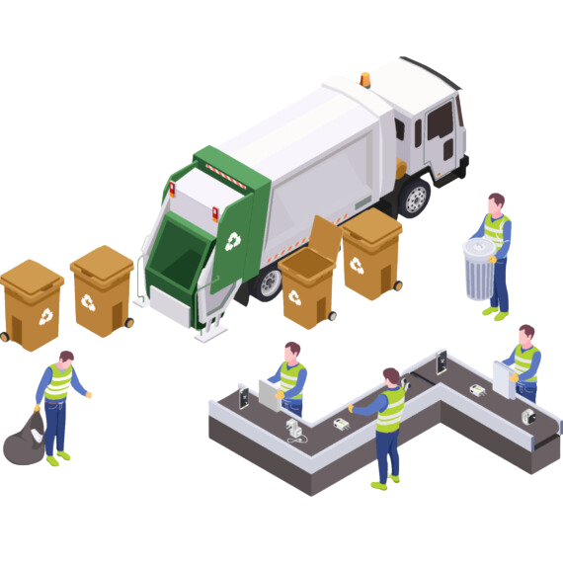
05
NON -FUNCTIONAL REQUIREMENTS
Scalability: Support growth in users, IoT devices, and trucks
Reliability: Ensure continuous uptime and system stability
Performance: Deliver real-time updates and notifications efficiently
Security: Protect data with encryption and controlled access
User-Friendly: Provide intuitive and accessible interfaces for all users
Profit Projections
Notes:
Besides functionality, the system must be scalable to handle more users and devices in the future. It should be reliable and secure, delivering real-time performance while protecting sensitive data. Most importantly, it must be intuitive and accessible for all users.

Slide 7












06
TECHNOLOGIES
Prototyping: Figma
Hardware (IoT Bin): ESP32, GPS (NEO-6M), LoRa/BLE, LEDs
Front-end Development: React, Flutter
Back-end Development: Node.js, Express.js
Databases: Firebase
Communication: ESP-NOW, MQTT, HTTP/HTTPS
Version Control: Git, GitHub
Notes:
o build this system, I’ve used a variety of tools and platforms:
IoT hardware includes ESP32, GPS modules, and communication protocols like LoRa and ESP-NOW.
The front end is built using React and Flutter, with Node.js and Express.js on the backend.
while Firebase is used for real-time database needs.
Version control is maintained through GitHub.

Slide 8

07
METHODOLOGY
Install IoT sensors in waste bins and use driver’s phone location tracking to collect real-time data on fill levels and truck locations, testing in controlled environments for accuracy.
Gather historical and real-time waste collection data from municipal records to optimize collection routes.
Conduct interviews and surveys with residents, truck drivers and administrators to define application requirements, followed by usability testing sessions to ensure effective notification delivery.
Implement request processing within the application and establish response protocols with collection teams, testing with a small user group before full implementation.
Notes:
For the methodology, I followed a step-by-step approach. First, I collected data through surveys, interviews, and field observations. This helped me understand user needs and system requirements. Based on that, I started developing the web and mobile applications using a user-centered design.

Slide 9
08
METHODOLOGY CONT.
Collect feedback through surveys and interviews with residents to design the community sharing feature, followed by prototype testing to ensure user-friendliness.
Create waste segregation guides in collaboration with environmental experts, delivering them via the app as visuals and brief instructions reviewed by users for clarity.
Generate reports using data collected from smart bins, the mobile app, and the web application.
Notes:
In the next stages, I will integrate IoT sensors and GPS tracking to collect real-time data, and use AI to optimize routes. Usability testing and feedback will guide improvements throughout the process. The system will also include features like request handling, community sharing, waste segregation guides, and a reporting tool—all tested with real users to ensure effectiveness.”

Slide 10


09
PROJECT COMPLETED SO FAR
Functional Requirements | Description | PR 1 | PR 2
Community Sharing | Users can post and share reusable items via mobile app
Immediate Pickups | Residents can request urgent pickups
User Management | Manage user accounts, roles (admin, driver, resident), and activity
Waste Collection Monitoring | IoT-enabled bins send real-time data on fill levels; users can schedule pickups
Alerts & Notifications | Real-time notifications for users and drivers
Route Optimization & Tracking | System generates optimized routes and updates them based on real-time data
Reports & Analytics | Generate insights on collection patterns, bin usage, and performance

Slide 11
THANK YOU !
Notes:
Thank You , so next move to the project , first you can see mobile app

